Slide 1
Tracking Real World Web Performance
NDC LONDON
Notes:
URL’s to open in link.html in Chrome
VS Solution
CMD Line
ZoomIt

Slide 2





OODA Loop
OBSERVE
5
ORIENT
5
DECIDE
5
ACT
STEP NO. 1
STEP NO. 2
STEP NO. 3
STEP NO. 4
Real User Metrics
Synthetic Lab
Research
Implement
h
Col. John Boyd
Notes:
Observe – collect current information from as many sources as practically possible.
Orient – analyze this information, and use it to update your current reality.
Decide – determine a course of action.
Act – follow through on your decision.
You continue to cycle through the OODA Loop by observing the results of your actions, seeing whether you've achieved the results you intended, reviewing and revising your initial decision, and moving to your next action.
Mention Full Stack Web Perf

Slide 3
METRICS
1
Notes:
Lets talk quick about how we measure web sites performance

Slide 4





Metrics
QUANTITATIVE
RULE BASED
MILESTONE
PERCEIVED
Notes:
Quantitative:
Number of Requests: Total/Images/Scripts/CSS
Page Weight: Total/Images/Scripts/CSS
Number of Domains
Number of Redirects
Business Metrics: Sales/Revenue/Items Purchased
Quantitative metrics basically tell you nothing about how a page will render. Two pages with the same number of requests or identical weight will render differently depending on how those resources get requested. Their main advantage is that they are much easier to conceptualize during design and development.
Rule Based:
Page Speed
YSlow
WebPageTest
Rule Based metrics are really valuable as a checklist of optimizations you should probably be doing, and are simpler than Quantitative metrics (if you can agree on one), but still don’t really tell you anything about how long it takes a page to render.
Milestone:
Milestone timings are time-based and measure performance based on a single point in time. They’re easy to describe and track since they are pervasive across tooling.
Examples include:
Time to First byte
Time to First Paint
Time to DomContentLoaded
Time to Load
Time to X/Custom

Slide 5
Milestone Metrics
#
5
Z
0
Q
https://stratusstore.com/login

Slide 6
Milestone Metrics - Time To First Byte
#
5
Z
0
Q
https://stratusstore.com/login

Slide 7






Milestone Metrics - Time To First Byte - details
#
5
Z
0
Q
https://stratusstore.com/login
_
<F12/> Tools ▸ Network
x
Status URL Type DNS TCP TLS TTFB Download
/ 200 /login html
/ 200 /style.css css
/ 200 /logo.png img

Slide 8
Milestone Metrics - Time To First Paint
#
Stratus Store - Safe Storage Login
5
Z
0
Q
https://stratusstore.com/login
stratus store
Notes:
This can be measured in Chrome via window.chrome.loadTimes().firstPaintTime and in IE via window.performance.timing.msFirstPaint

Slide 9
Milestone Metrics - Time To DomContentLoaded
#
Stratus Store - Safe Storage Login
5
Z
0
Q
https://stratusstore.com/login
stratus store
sign in
email@domain.com
password
Remember Me?
sign in
Notes:
DOM is ready, assets still loading

Slide 10

Milestone Metrics - Time To Load
r
#
Stratus Store - Safe Storage Login
5
Z
0
Q
https://stratusstore.com/login
sign in
email@domain.com
password
stratus
Remember Me?
sign in
store
Notes:
Assets loaded

Slide 11
Milestone Metrics - Time To X?
r
#
Stratus Store - Safe Storage Login
5
Z
0
Q
https://stratusstore.com/login
sign in
nikmd23@gmail.com
|
stratus
Remember Me?
sign in
store
Notes:
What about a custom metric? Time to password focus in this example

Slide 12
Metrics
QUANTITATIVE
RULE BASED
MILESTONE
PERCEIVED
Notes:
Web performance isn’t defined by a single number, score or moment.
One page may take 3 seconds to load, but not display anything until the 2.5 second mark.
Another page may take 5 seconds to load, but display the majority of the content after only a second.
Despite taking 2 seconds longer in total, the second page may be the better experience.
The Perceived metrics attempt to take situations like this into account – but its an imprecise science. Whereas traditional metrics focused on a single moment, Perceived metrics attempt to measure the full experience. They focuses not just on how long it took for everything to display on a page, but how the page progressed from start to finish. Google, Microsoft and several other vendors have attempted to produce Perceived metrics, but those attempts have mostly failed due to the complexity of the approach. SpeedIndex is currently the best we have.
More on that in a bit.
Perceived:
Google’s Above The Fold Render Time: http://assets.en.oreilly.com/1/event/62/Above%20the%20Fold%20Time_%20Measuring%20Web%20Page%20Performance%20Visually%20Presentation.pdf
Speed Index: https://sites.google.com/a/webpagetest.org/docs/using-webpagetest/metrics/speed-index
Microsoft’s Page Phase Time: http://cdn.oreillystatic.com/en/assets/1/event/99/Going%20Beyond%20onload%20-%20How%20Fast%20Does%20It%20Feel_%20Presentation.pptx
User-ready: http://cdn.oreillystatic.com/en/assets/1/event/99/Going%20Beyond%20onload%20-%20How%20Fast%20Does%20It%20Feel_%20Presentation%201.pdf

Slide 13


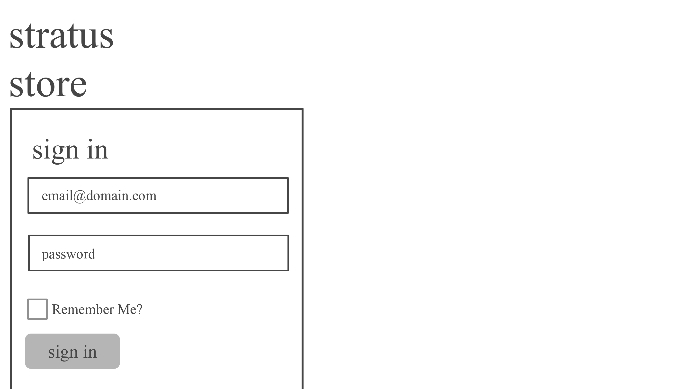

PERCEIVED Metrics – Percent Complete
TIME
1.0
1.5
2.0
2.5
3.0
0%
0%
14%
57%
95%
COMPLETE

Slide 14
PERCEIVED Metrics - Speed Index

Slide 15
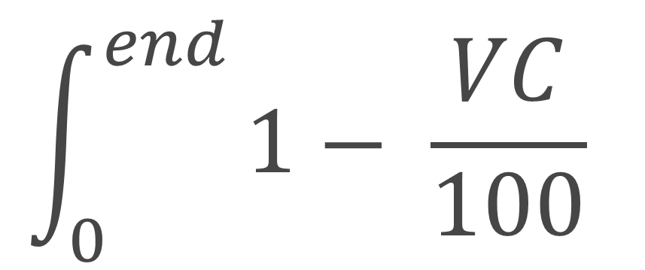
PERCEIVED Metrics - Speed Index
Speed Index:
$$\int_{0}^{end}{1− \frac{VC}{100}}$$

Slide 16
PERCEIVED Metrics - Speed Index

Slide 17
PERCEIVED Metrics - Speed Index
Speed Index: 1343 ms

Slide 18
PERCEIVED Metrics - Speed Index

Slide 19
PERCEIVED Metrics - Speed Index
Speed Index: 9177 ms

Slide 20
Average

Slide 21
Average
Average: 16

Slide 22
Median

Slide 23
Median
Average: 16

Slide 24
Median
Median: 19

Slide 25
Histogram
0
4
8
12
16
20
24
Notes:
Bimodal distribution
Sturges formula is a good starting point to figure out the number of bins

Slide 26
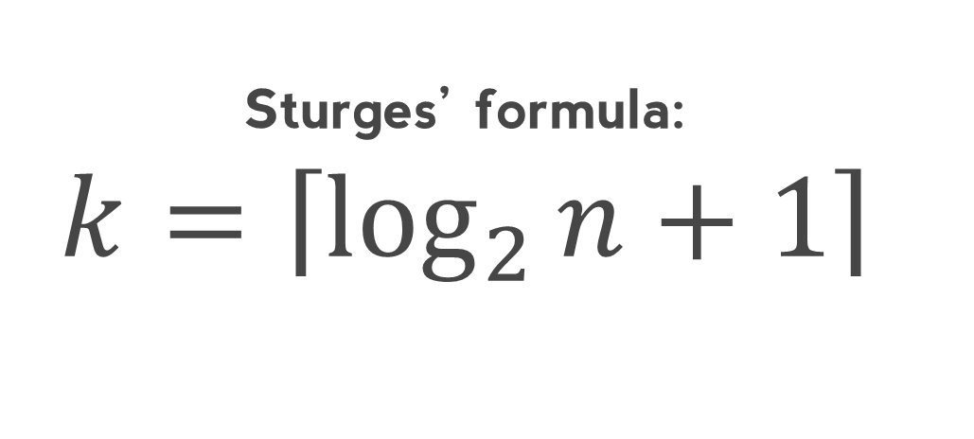
Histogram
Sturges’ formula: $$k=\left\lceil \log_{2}{n+1}\right\rceil$$
0
4
8
12
16
20
24
Notes:
Bimodal distribution
Sturges formula is a good starting point to figure out the number of bins

Slide 27
REAL USER METRICS
2
Notes:
All too often we as developers suffer from “works on my machine” syndrome.

Slide 28

REAL USER METRICS
2
- +
works on my machine
Notes:
Only technique that measures the “last mile”
Potentially generates lots of noise
Great for answering “How fast is the page?”

Slide 29

Web Performance Working Group
“
The mission of the Web Performance Working Group is to provide methods to measure aspects of application performance of user agent features and APIs.
NAVIGATION
RESOURCE
USER
Allows JavaScript mechanisms to provide complete client-side latency measurements within applications
Allow JavaScript mechanisms to collect complete timing information related to resources on a document
Expose a high precision timestamp to developers so they can better measure the performance of their applications
AND MORE…

Slide 30





Navigation Timing
redirect
App cache
DNS
TCP
Request
Response
Processing
load
unload
DOM Content Loaded
9
6
7
8
M
Notes:
[Demo]
window.performance.timing
Navigation Timing Bookmarklet

Slide 31
Navigation Timing
connectStart
navigationStart
secureConnectionStart
responseEnd
domLoading
redirectStart
fetchStart
domainLookupStart
requestStart
responseStart
domInteractive
loadEventStart
redirect
App cache
DNS
TCP
Request
Response
Processing
load
unload
DOM Content Loaded
redirectEnd
domainLooupEnd
connectEnd
loadEventEnd
domComplete
unloadEventStart
domContentLoadedEventEnd
unloadEventEnd
domContentLoadedEventStart
9
6
7
8

Slide 32
Resource Timing
redirect
App cache
DNS
TCP
Request
Response
10
25
34
M
Notes:
[Demo]
table(window.performance.getEntriesByType('resource'))
Resource Timing Bookmarklet

Slide 33
Resource Timing
connectStart
startTime
secureConnectionStart
redirectStart
fetchStart
domainLookupStart
requestStart
responseStart
redirect
App cache
DNS
TCP
Request
Response
redirectEnd
domainLooupEnd
connectEnd
responseEnd
10
25
34
Notes:
CORS resources w/ Timing-Allow-Origin : *
http://bigqueri.es/t/how-many-and-which-resources-have-timing-allow-origin-for-resource-timing/152

Slide 34
User Timing
twttr.ready(function(twttr) {
performance.mark('twitter_ready');
twttr.events.bind('rendered', function() {
performance.mark('twitter_rendered');
performance.measure('twitter_render_time',
'twitter_ready',
'twitter_rendered');
});
});
10
25
M
Notes:
[Demo]
Show Mascot.cshtml
Performance Bookmarklet

Slide 35
Beacon
window.addEventListener('unload', function() {
var rum = {
// build up any beacon data
navigation: performance.timing,
resources: performance.getEntriesByType('resource'),
marks: performance.getEntriesByType('mark'),
measures: performance.getEntriesByType('measure')
};
navigator.sendBeacon('/rum/submit', JSON.stringify(rum));
});
UC
39
31
M
Notes:
[Demo]
Show rum.js
Browse to see “true” in console
Show RumController, Rum, ResourceTiming
Too much data can be a problem, because Chrome/Opera limits to 16KB, solve it by:
Re-encoding like I do
Split across beacons to get partial results
Use DomString instead of FormData
Fewer resources on a page
Get it sooner by flipping flags:
chrome://flags/#enable-experimental-web-platform-features (full in 39)
about:config dom.enable_resource_timing (full in 34)
Helps to preserve log on Console and Network tabs

Slide 36
SYNTHETIC TESTING
3
Notes:
Limited in browser & geographical coverage
Great for answering “How can I make the page faster?”

Slide 37



WebPagetest
J
M
Notes:
[DEMO]
Show how to basically setup a test and run. But no need to wait w/ pre cooked results
View All Mascots (Prod) to show all 9 runs and median
Plot Full Results
Waterfall
CPU/Bandwidth Utilization
Connection View
Comparison
Filmstrip & Comparison End Point
“Scrubbing” Waterfall
Visual Completeness Graph
SPOF
Can manipulate many variables, including connection and SPOF
TCP Dump for deep insights
Custom Metrics?
[width]
Return window.innerWidth;

Slide 38
RUM VS Synthetic
Notes:
How Fast Is The Page vs How Can I Make The Page Faster?
The issue with only showing synthetic data is that it typically makes a website appear much faster than it actually is. This has been true since I first started tracking real user metrics back in 2004. My rule-of-thumb is that your real users are experiencing page load times that are twice as long as their corresponding synthetic measurements.
RUM data, by definition, is from real users. It is the ground truth for what users are experiencing. Synthetic data, even when generated using real browsers over a real network, can never match the diversity of performance variables that exist in the real world: browsers, mobile devices, geo locations, network conditions, user accounts, page view flow, etc. The reason we use synthetic data is that it allows us to create a consistent testing environment by eliminating the variables. The variables we choose for synthetic testing matches a segment of users (hopefully) but it can’t capture the diversity of users that actually visit our websites every day. That’s what RUM is for.

Slide 39
CONTINUOUS IMPROVEMENT
4

Slide 40


CI Tools
O
Page Speed Insights
Web Page Test
perf-tooling.today
Phantomas
Too Many Images
and many more…
UnCss
PerfBudget
perf.rocks
M
Notes:
[Demo]
gulp psi
gulp perfbudget
gulp phantomas
gulp tmi
Optimize an existing feature or asset on the page
Remove an existing feature or asset from the page
Don’t add the new feature or asset

Slide 41
What’s Fast Enough?
5

Slide 42

How Fast?
100 ms Feels Instant 1,000 ms Uninterrupted Thought 10,000 ms Lose Attention
…
1,000 ms Recommended SpeedIndex
...
? ms Competitive Analysis
Notes:
There are 3 main time limits (which are determined by human perceptual abilities) to keep in mind when optimizing web and application performance. They were originally published in 1968, and re-confirmed by Jakob Nielsen again in 1993 and 2005.
0.1 second is about the limit for having the user feel that the system is reacting instantaneously, meaning that no special feedback is necessary except to display the result.
1.0 second is about the limit for the user's flow of thought to stay uninterrupted, even though the user will notice the delay. Normally, no special feedback is necessary during delays of more than 0.1 but less than 1.0 second, but the user does lose the feeling of operating directly on the data.
10 seconds is about the limit for keeping the user's attention focused on the dialogue. For longer delays, users will want to perform other tasks while waiting for the computer to finish, so they should be given feedback indicating when the computer expects to be done. Feedback during the delay is especially important if the response time is likely to be highly variable, since users will then not know what to expect.
These numbers are upper bounds, not goals.

Slide 43
Median Everything
SELECT
NTH(50, QUANTILES(speedIndex, 100)) AS speedIndex,
NTH(50, QUANTILES(ttfb, 100)) AS ttfb,
NTH(50, QUANTILES(onLoad, 100)) AS onLoad,
NTH(50, QUANTILES(reqTotal, 100)) AS reqTotal,
NTH(50, QUANTILES(bytesTotal, 100)) AS bytesTotal,
NTH(50, QUANTILES(numDomains, 100)) AS numDomains,
NTH(50, QUANTILES(pageSpeed, 100)) AS pageSpeed
FROM [httparchive:runs.latest_pages]
M
Notes:
[Demo]
Show latest schema
Run this query
Run next query

Slide 44
SpeedIndex Percentiles
SELECT
NTH(10, QUANTILES(speedIndex, 100)) tenth,
NTH(25, QUANTILES(speedIndex, 100)) twenty_fifth,
NTH(50, QUANTILES(speedIndex, 100)) median,
NTH(75, QUANTILES(speedIndex, 100)) seventy_fifth,
NTH(90, QUANTILES(speedIndex, 100)) ninetieth
FROM [httparchive:runs.latest_pages]

Slide 45
Status Code Usage
SELECT status, ROUND(100 * ratio) AS percent, total
FROM (
SELECT status,
COUNT(*) AS total,
RATIO_TO_REPORT(total) OVER() ratio
FROM [httparchive:runs.latest_requests]
GROUP BY status
)
ORDER BY total DESC

Slide 46
3rd Party Usage
SELECT DOMAIN(req.url) third_party, COUNT(*) num_requests
FROM [httparchive:runs.latest_requests] AS req
JOIN (
SELECT DOMAIN(url) self, pageid
FROM [httparchive:runs.latest_pages]
) AS pages ON pages.pageid = req.pageid
WHERE DOMAIN(req.url) != pages.self
GROUP BY third_party
ORDER BY num_requests DESC

Slide 47




Thank you
NIKCODES.COM
BITLY.COM/ TRACKING-REAL-WORLD-WEB-PERF
QUESTIONS?
@NIKMD23
?

